Slide 1

Belarus, Minsk 2016

Slide 2
Team
Manager, software engineer | Aliaksei Kutsevol
Mechanical engineer, designer | Gleb Vasiliev
Artist | Anna Vasilieva
Doctor/Psychotherapist | Еvgenia Tochitskaya
Software engineer/ anchor | Vadim Egoraev
Chemist | Vasily Borisyonok
Physicist | Yury Adamov
Hardware engineer | Mykolay Kovchak

Slide 3

RElife
Your chance to survive

Slide 4
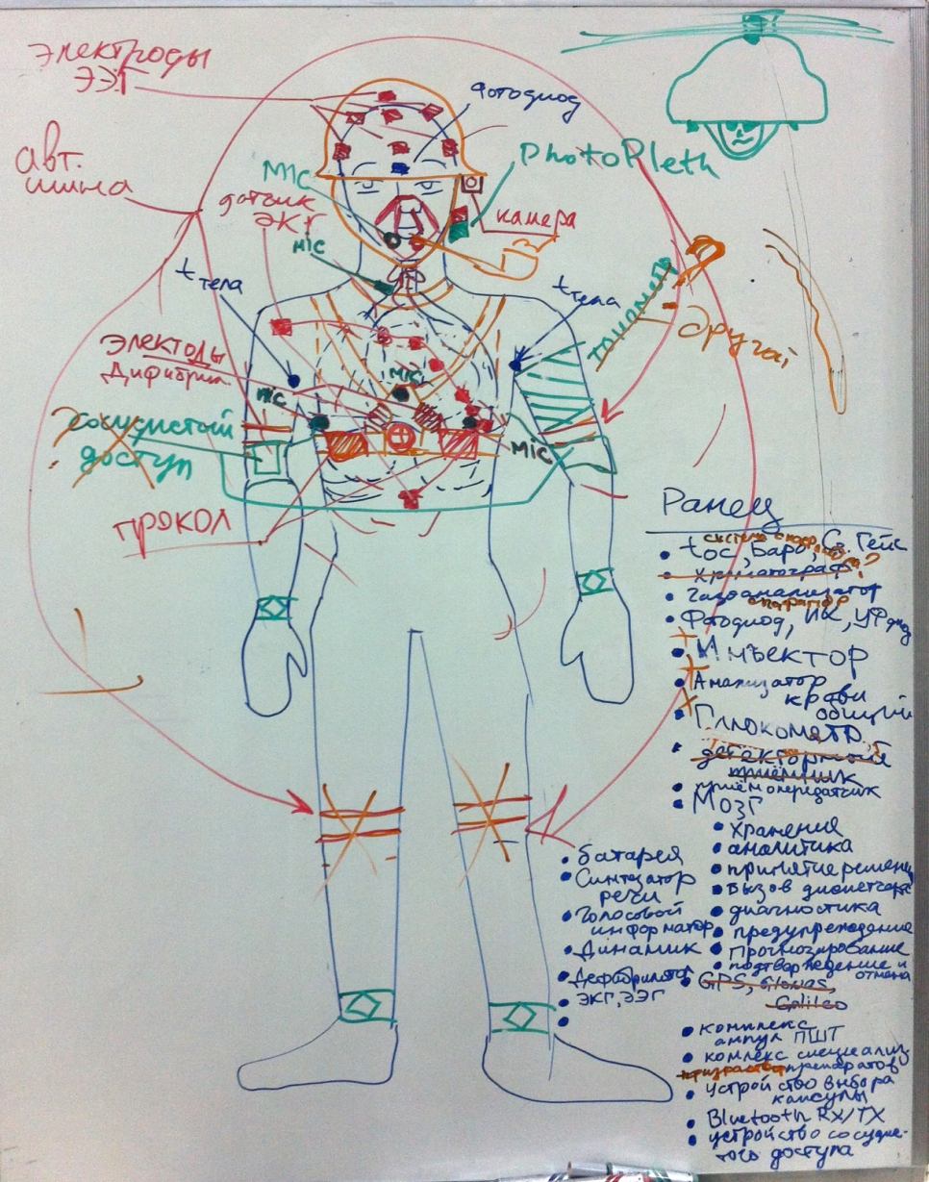
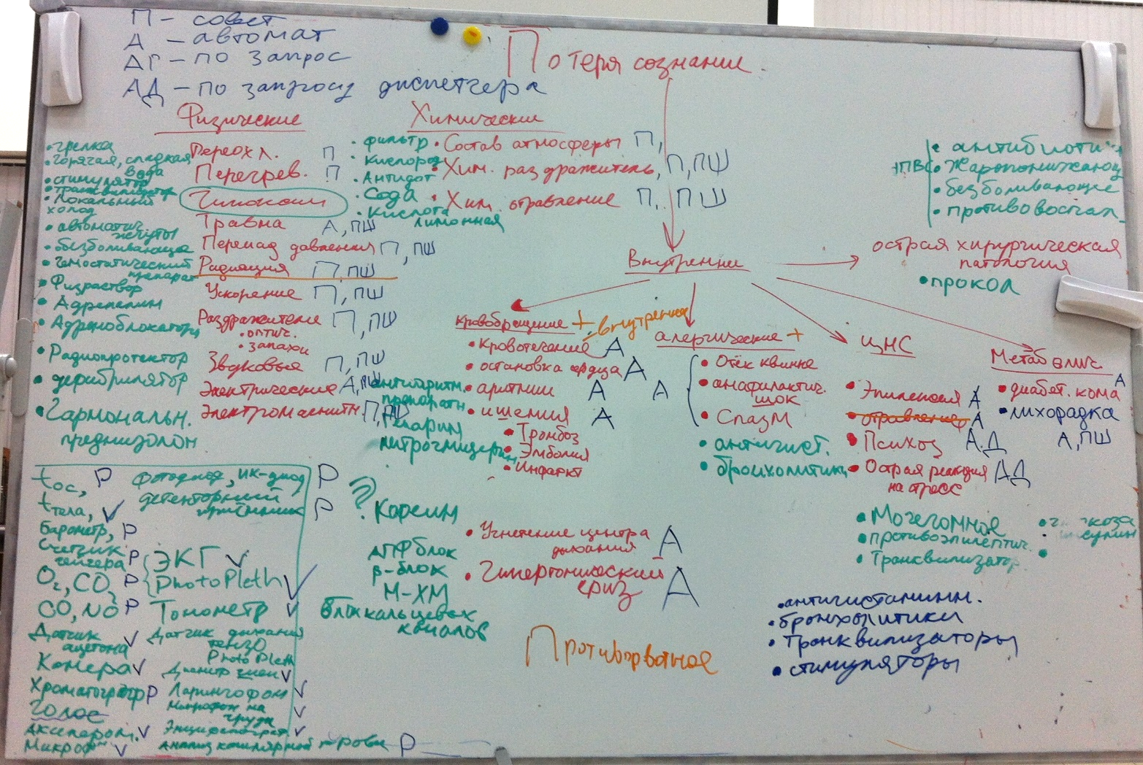
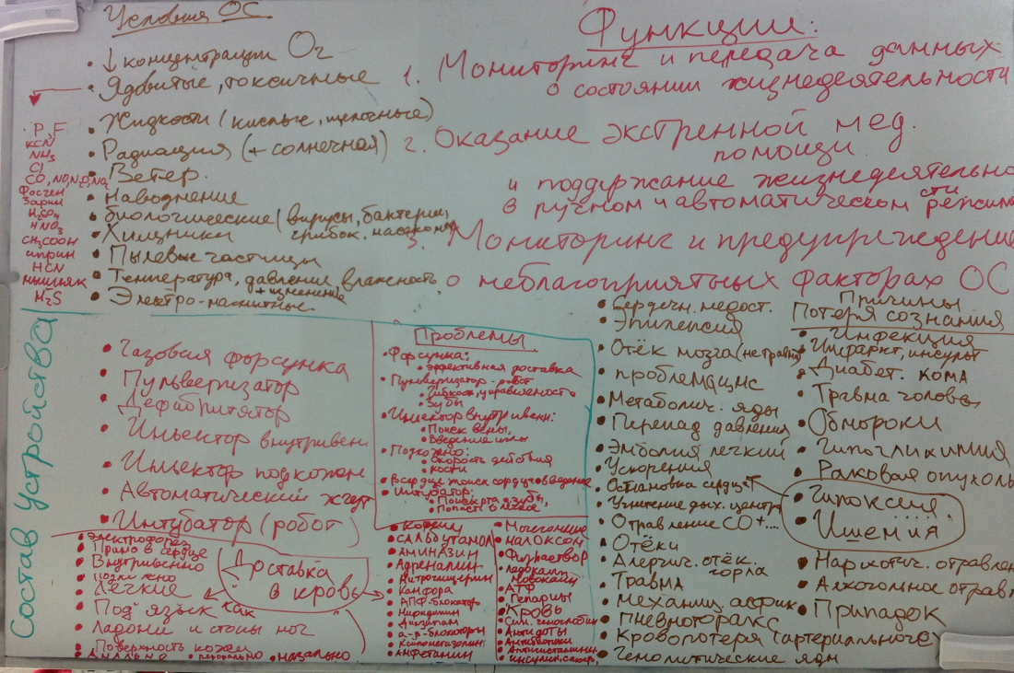
Brainstorming

Slide 5
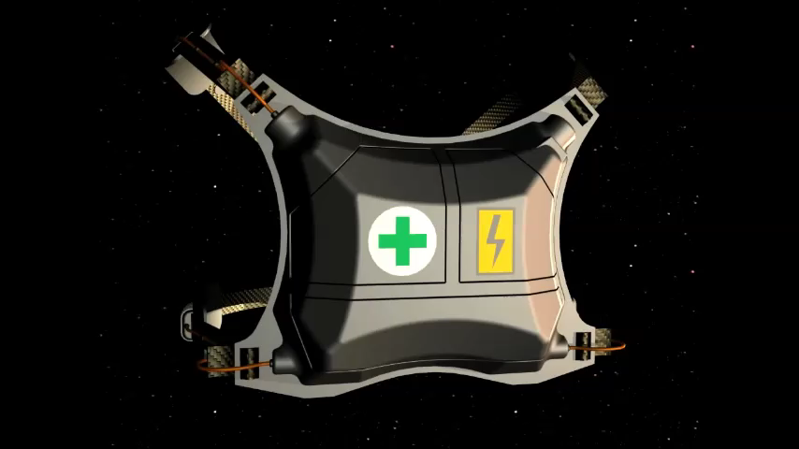

Slide 6
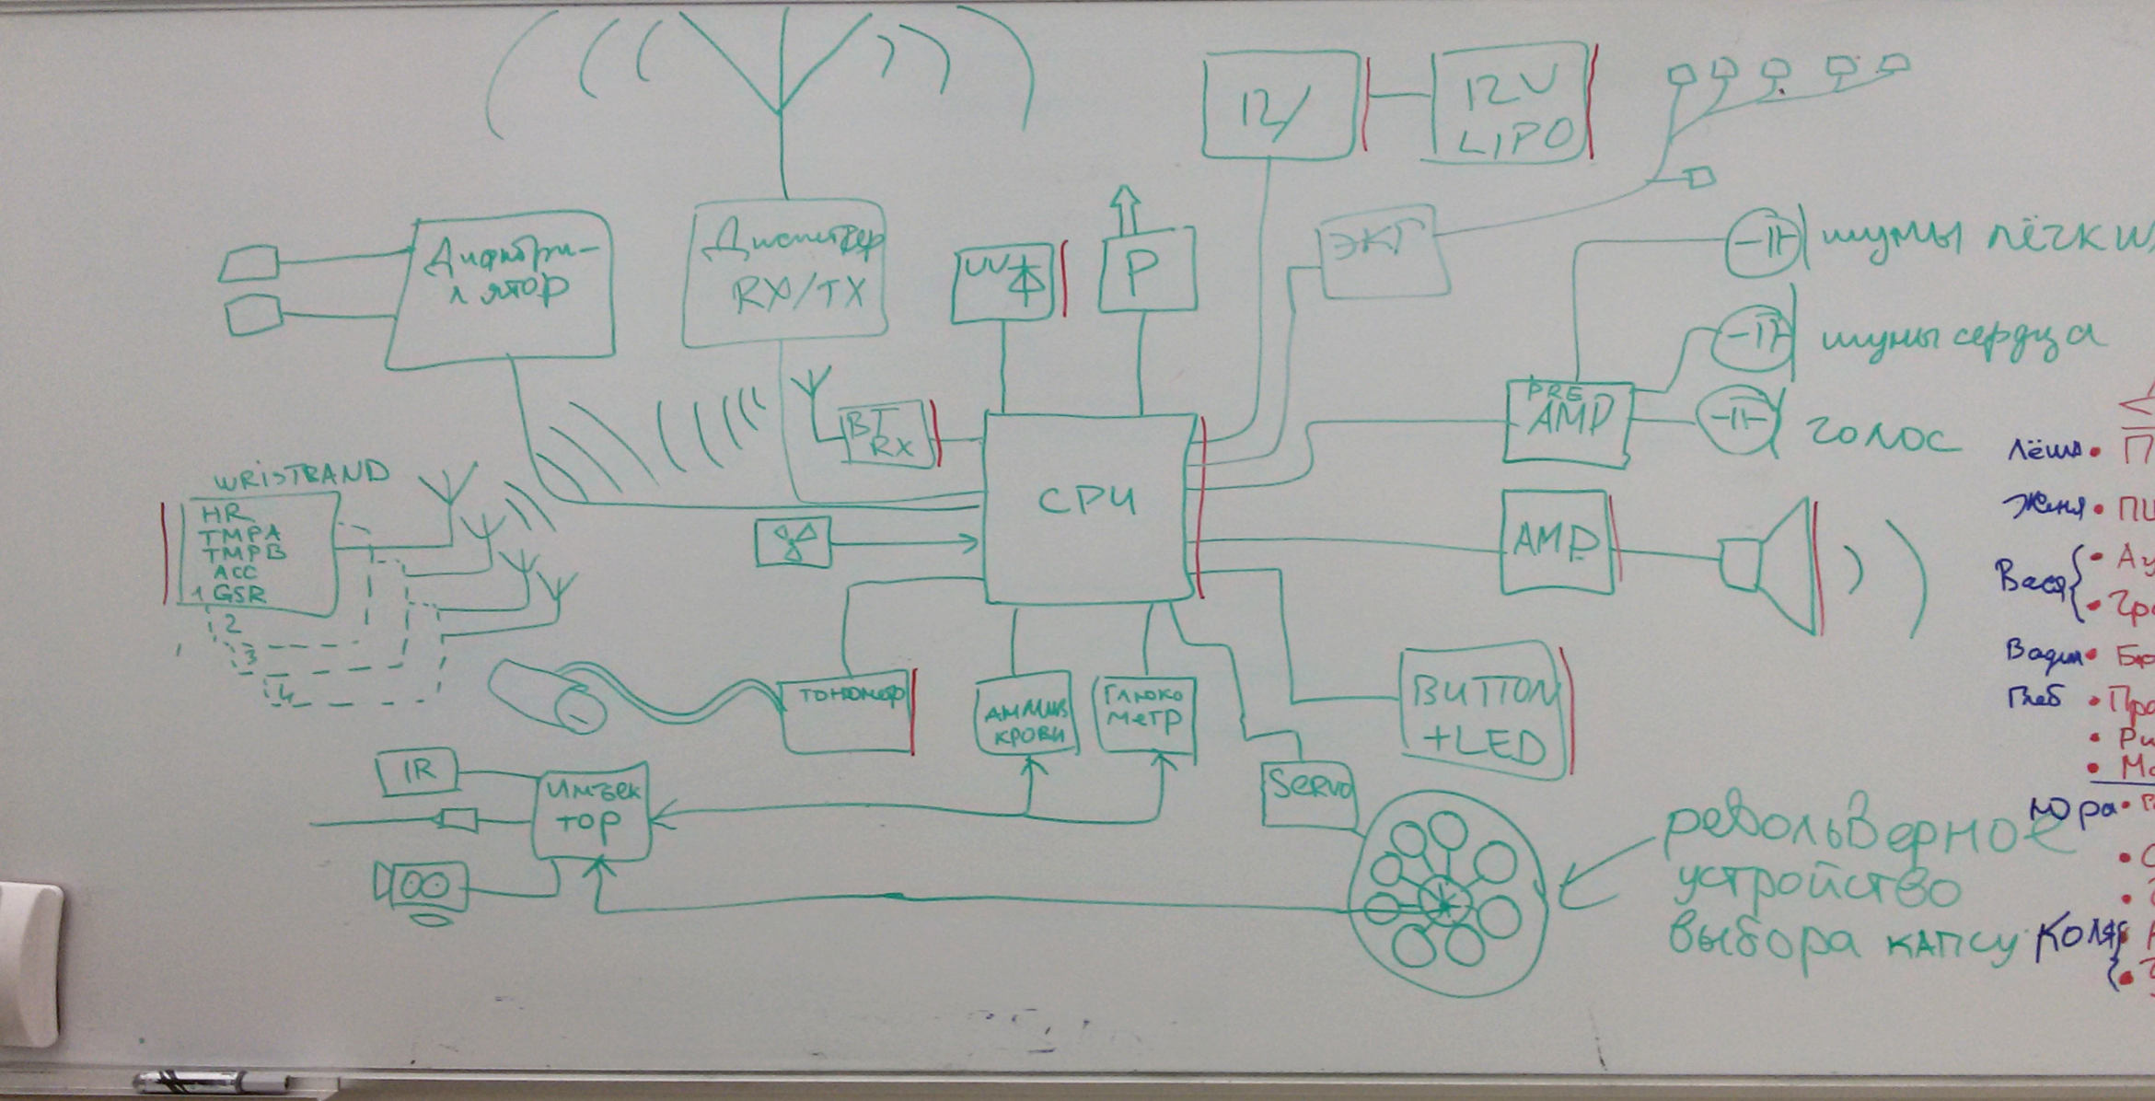
High level schematics

Slide 7
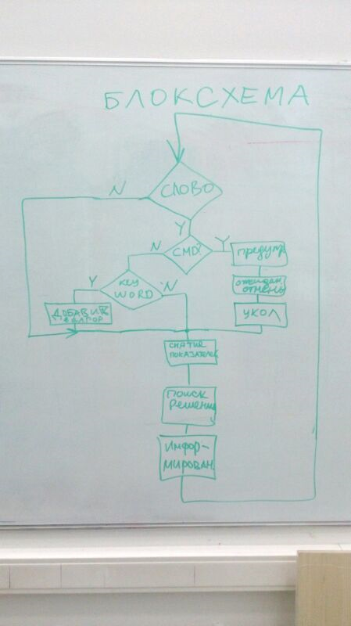

Slide 8
Software:
Voice recognition
Basic decision making
Technology:
Google API for voice recognition
Festival voice syntesis
Python, Linux
Raspberry Pi
Custom hardware

Slide 9
Algorithm
Respiratoy activity
Peripheral arterial pulse
Heartbeat
Pupillary light reflex
Defibrillation
CPR
Intramuscular injection of atropine, epinephrine
Yes
No
Hypoxia
Cyanosis
Respiratory malfunction
Arterial blood pressure fall
Increase of heart rate
Blood glucose level
Increased
Insuline administration
No
Bubbling breathing, rising of cyanosis and hypoxia
Decreased
Norm
Acute chest pain
Norma
ECG
Yes
Trauma existance
Yes
Sudden right heart overload
Yes
Protocolол
"Pulmonary Edema”
Glucose administration
Yes
Further investigations (EEG, clinical blood analysis and so on)
Breath sounds asymmetry
Arrhythmia
Ischemia or infarct
No
Protocol “Chest Trauma”
No
Protocol «Treatment “PATE”
Yes
Pneumothorax
Protocol “Arrhythmia”
Protocols “Angina Attack” or “Myocardial Infarction”
Protocol “Pneumothorax”

Slide 10
Methods of influence on human organism
1. Verbal
2. Defibrillation
3. Automatic cardiopulmonary resuscitation
4. Puncture of intercostal space for closed pneumothorax emergency care
5. Earlobe electric stimulation
6. Medicamentous
Intramuscular injections
Oral spray
Sublingual drugs

Slide 11
Detectors
1. Transcutaneous blood gas analysis (on the earlobe):
hemoglobulin
bilirubin
glucose
Blood gas concentration.
2. Clinical blood analysis (invasive method, analyser is in the backpack)
Chemistry Panel
Formed elements
3. Videocamera for registering of scin coloration pupillary diameter, inequality of pupils and facial expression
4. EEG
5. ECG
6. Close-talking microphone
7. Trachea-sound microphone
8. Heart-sound microphone
9. Lower Lung lobes-sound microphones
10. Axillary temperature detectors (two pieces)
11. Accelerometers (4 pieces)
12. Blood pressure detector (finger clip sensor)
13. Photodetector, IR- and UV-detectors

Slide 12
Medicines
Pharmacological class | Drug | Mode of administration
Adrenergic agonists | Epinephrine | Hypodermic injection
Muscarinic antagonists | Atropine | Intramuscular injection
Glucocorticosteroids | Prednisolone | Intramuscular injection
Analgesics | Morphine | Intramuscular injection
Nonsteroidal antiinflammatory drugs | Ketorolac | Intramuscular injection
Bronchial spasmolytics | Salbutamol | Oral spray
Antiarrhythmics | Lidocaine, amiodarone | Intramuscular injection
Nitrates | Nitroglycerin | Oral spray
ACE inhibitors | Captopril | Intramuscular injection
Antiemetics | Metoclopramide | Intramuscular injection
Neuroleptics | Haloperidol | Intramuscular injection
Anxiolytics | Diazepam | Intramuscular injection
Anticoagulants | Heparin | Hypodermic injection
Hormones | Insulin | Hypodermic injection
Сarbohydrate delivery agent | Glucose | Solution per os
Diuretics | Furosemide | Intramuscular injection

Slide 13
Thanks for attention!
And be in good health!

